Slide 1
Software Measurement
Project - Team L
SOEN-6611
submitted By:
Zubin Mehta
Sandeep Singh
Gursimrat Kaur

Slide 2
Outline
System Overview
Metric 1 & 2 – Statement and Branch coverage
Metric 3 – Mutation score
Correlation between Metric 1, 2 and 3
Metric 4 – Cyclomatic complexity – McCabe complexity
Correlation between Metric 1, 2 and 4
Metric 5 – Defect removal density
Metric 6 – Post- Release defect density
Correlation between Metric 5 and 6
Correlation between Metric 1, 2 and 6
References

Slide 3
System Overview
There are 3 open source systems listed below
Team L
S.N.O | System Name | Version | LOC | Contributors
1. | ImageJ | ImageJ 1.52m11 | 149,041 | 7
2. | Checksum | Checksum 1.8 | 4,929 | 14
3. | Checkstyle | Checkstyle 8.17 | 260,898 | 231

Slide 4
Metric 1&2 : Statement and Branch Coverage
Plugin/Tool Used : EclEmma Java Code Coverage
Version: 3.1.1.201809121651
IDE Used: Eclipse
Summary
System Name | Counter | Coverage | Covered | Missed | Total
ImageJ | Lines | 95.3% | 14333 | 701 | 15034
 | Branches | 85.7% | 1982 | 331 | 2313
Checksum | Lines | 29.6% | 246 | 584 | 830
 | Branches | 11.7% | 31 | 235 | 266
Checkstyle | Lines | 61% | 58616 | 37538 | 96154
 | Branches | 61.6% | 14159 | 8820 | 22979

Slide 5
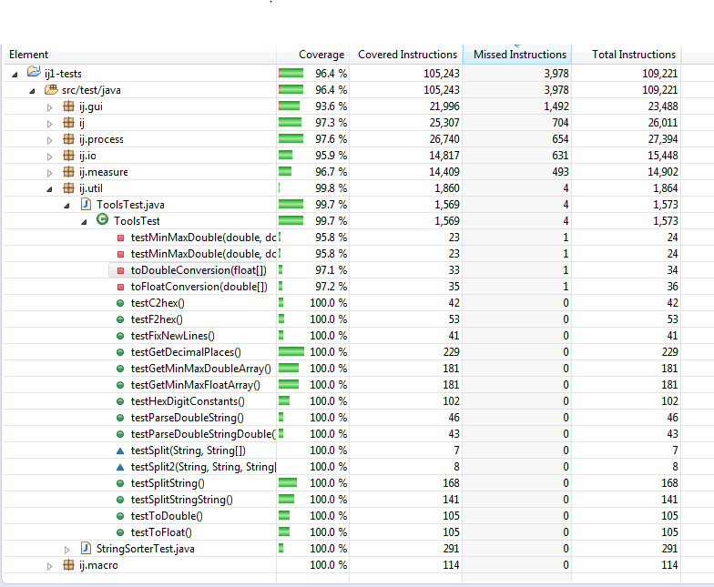
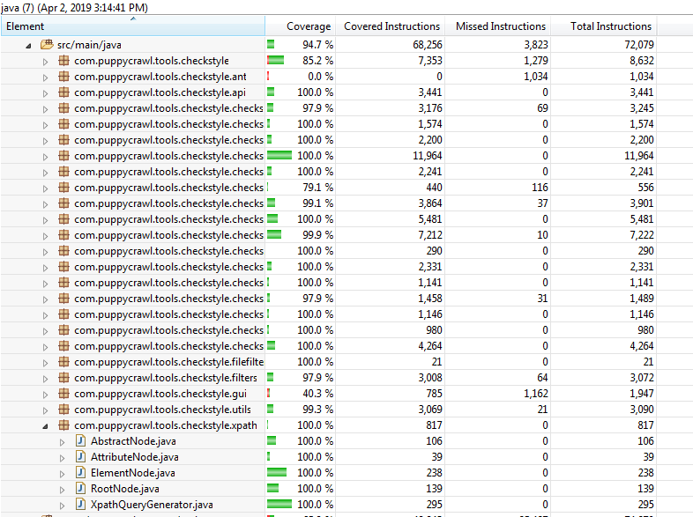
Metric 1&2 : Statement and Branch Coverage
Coverage- ImageJ
Coverage- Checkstyle

Slide 6
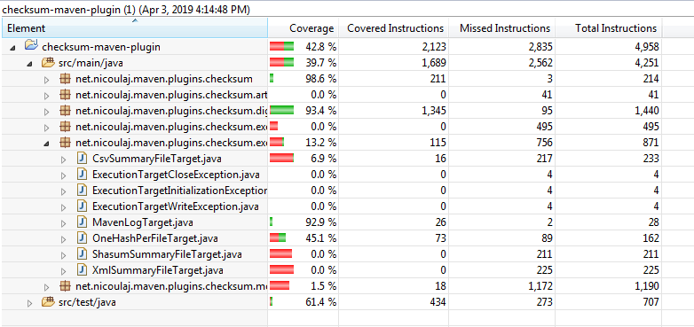
Coverage- Checksum

Slide 7
Metric 3 : Test Suite Effectiveness – Mutation Score
VoidMethodCallMutator - VCM
InlineConstantMutator - ICM
MemberVariableMutator - MVM
ReturnValsMutator - RVM
ConstructorCallMutator - CCM
NegateConditionalsMutator - NCM
NonVoidMethodCallMutator - NVCM
RemoveConditionalMutator_EQUAL_ELSE - RCM_EE
RemoveConditionalMutator_EQUAL_IF - RCM_EI
BooleanTrueReturnValsMutator - BTRM
BooleanFalseReturnValsMutator - BFRM
ConditionalsBoundaryMutator - CBM
IncrementsMutator - IM
InvertNegsMutator - INM
MathMutator - MM
Plugin/Tool Used : Pitclipse
Version: 1.1.6.201607050705
IDE Used: Eclipse, IntelliJ
Summary:
System Name | No. of Mutants Generated | No. of Mutants Killed | Mutation Score ((#Mutants Generated/#Mutants killed)*100) | No. of Test Ran | Types of Mutators
ImageJ | 73 | 35 | 48% | 35 (0.48 tests per mutation) | VCM, ICM, MVM, RVM, CCM, NCM, NVCM, RCM_EE, RCM_EI
Checksum | 292 | 46 | 16% | 96 (0.33 tests per mutation) | CBM, IM, VCM, RVM, MM, NCM
Checkstyle | 345 | 103 | 30% | 197 (0.57 tests per mutation) | BTRM, BFRM, CBM, IM, INM, MM, VCM, RVM, CCM, NCM

Slide 8
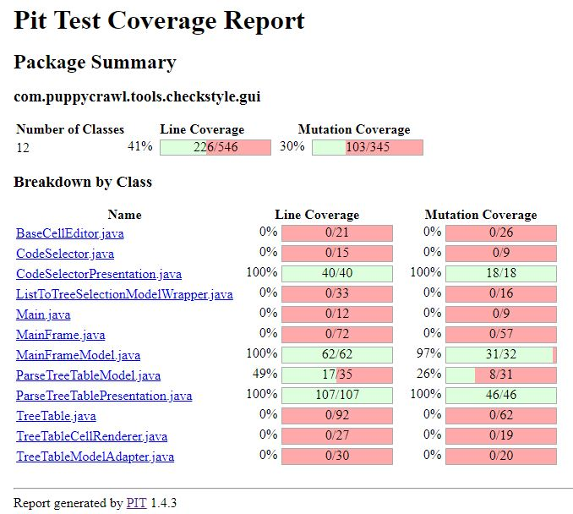
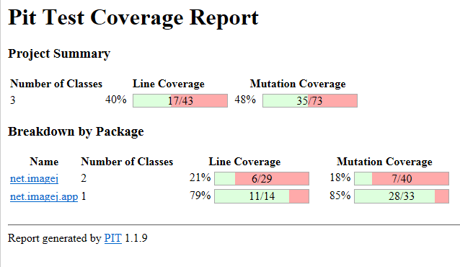
Metric 3 : Test Suite Effectiveness – Mutation Score
Checkstyle – Pitest Report
ImageJ – Pitest Report

Slide 9
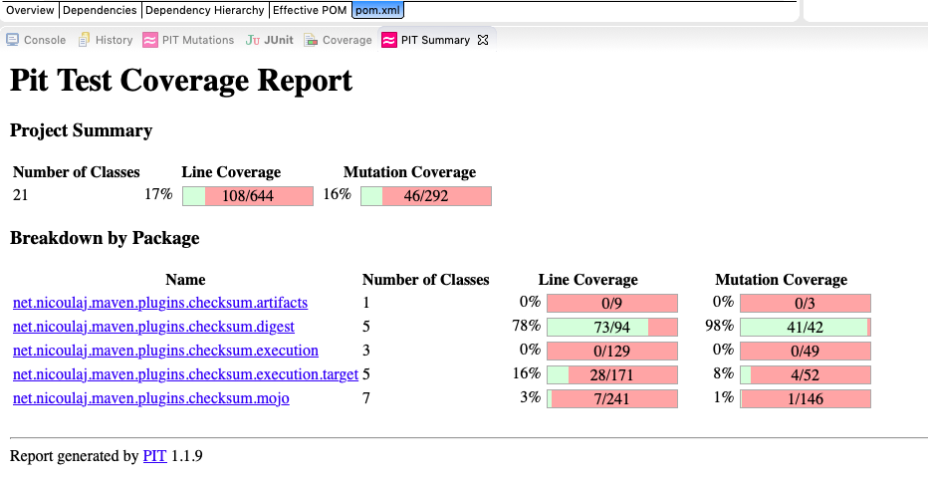
Checksum– Pitest Report

Slide 10
Correlation between Metric 1, 2 and 3
Strong test suites ensures the correctness and quality of the software.
Coverage and mutation score has been greatly used to evaluate test suite effectiveness.
The result shows that, the metric 1,2 and 3 has a positive correlation between them which implies that test suite with high coverage has high mutation score.
The ImageJ has the highest coverage and mutation score than the checksum and checkstyle.
It can be depicted from the results that, the ImageJ has the greater effectiveness of their test suites in comparison with other two systems.
Checksum has the least branch coverage and therefore it’s mutation score is lowest.

Slide 11
Metric 4 : Complexity Metric – McCabe Complexity
Plugin/Tool Used : McCabe IQ
Version: v 8.5
Summary
System Name | Cyclomatic Complexity | Essential Complexity | Design Complexity | Lines
ImageJ - 12 directories, 330 file(s), 7116 module(s) | 38111 | 17729 | 25822 | 109844
Checksum 9 directories, 35 file(s), 155 module(s) | 345 | 317 | 326 | 1224
Checkstyle 345 directories,1432 file(s), 11148 modules | 18988 | 13057 | 15788 | 73279

Slide 12
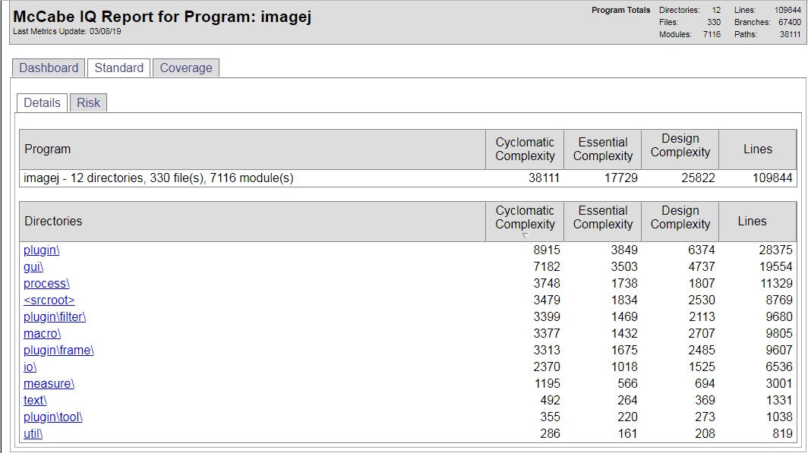
Metric 4 : Complexity Metric – McCabe Complexity
McCabe Report - ImageJ

Slide 13
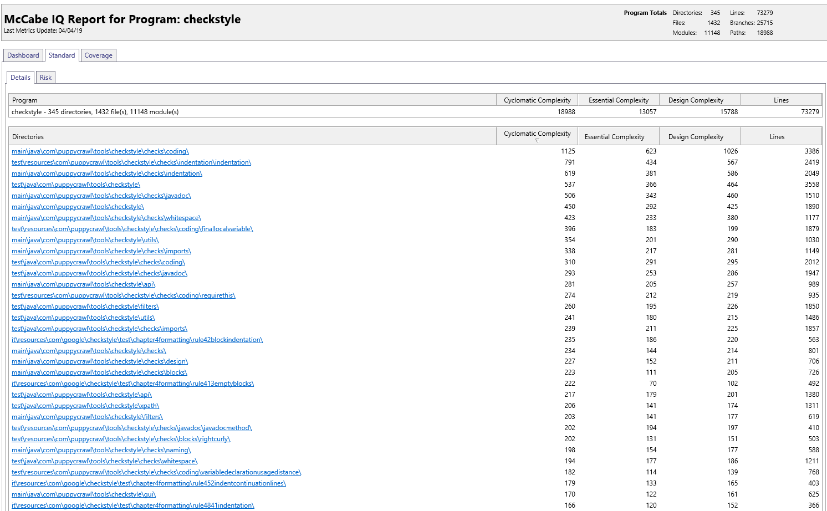
Metric 4 : Complexity Metric – McCabe Complexity
McCabe Report - Checkstyle

Slide 14
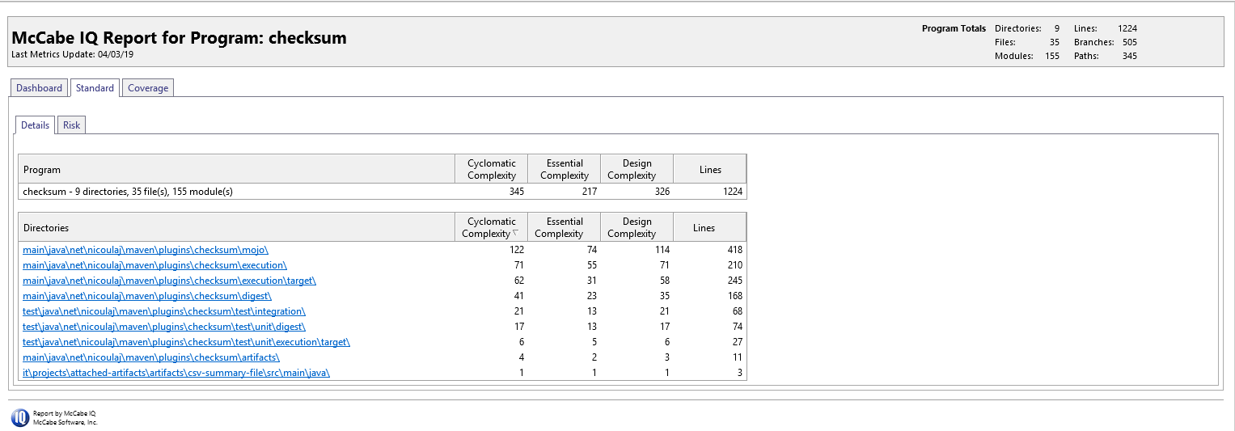
Metric 4 : Complexity Metric – McCabe Complexity
McCabe Report - Checksum

Slide 15
Correlation between Metric 1, 2 and 4
Cyclomatic complexity is the measure of number of linearly independent paths executed in the source code.
The number of test cases is equal to the number independent paths.
Higher the number of branches in the source code, the larger is the complexity of the code.
Checkstyle has the 73279 lines executed with the cyclomatic complexity of 18988 which is higher then the checksum with 1224 lines executed and having cyclomatic complexity of 345.
From the results it can be deduced that, the system with large coverage has the more cyclomatic complexity.

Slide 16
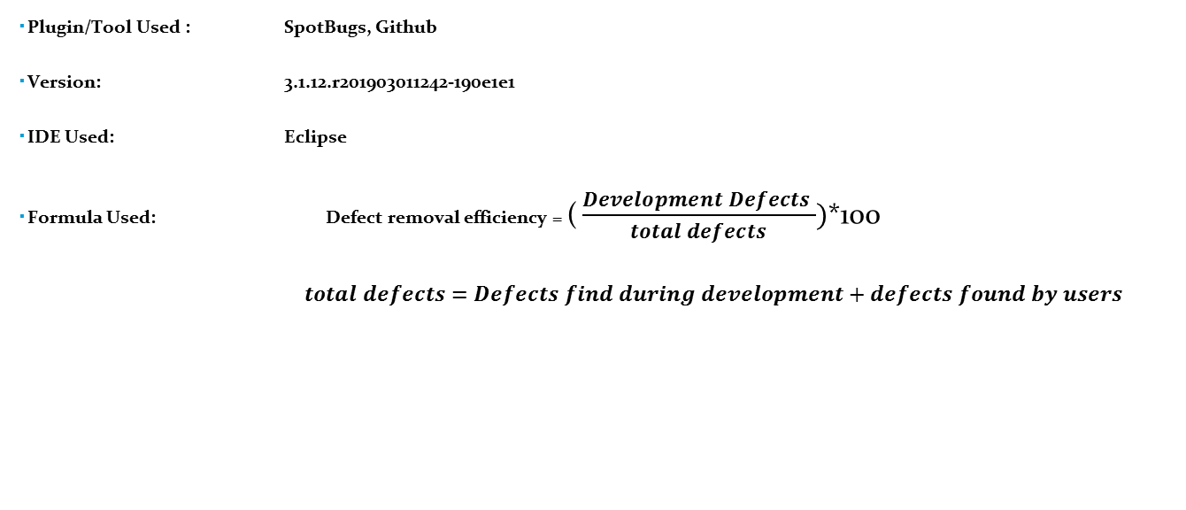
Metric 5 : Defect Removal Efficiency (DRE)

Slide 17
Summary
System Name | Version 1 |  | Version 2 |  | Version 3 |  | Version 4 |  | Version 5(Latest) |  | DRE (Defect Removal Efficiency)
 | No. of Defects Found |  | No. of Defects Found |  | No. of Defects Found |  | No. of Defects Found |  | No. of Defects Found
 | During Development phase | By user | During Development phase | By user | During Development phase | By user | During Development phase | By user | During Development phase | By user
ImageJ | 3605 | 12 | 3632 | 12 | 3635 | 12 | 3648 | 13 | 3646 | 13 | 99%
Checksum | 10 | 3 | 10 | 4 | 10 | 5 | 15 | 5 | 16 | 7 | 71.4%
Checkstyle | 8797 | 426 | 8805 | 445 | 8813 | 452 | 8903 | 464 | 9009 | 482 | 94.8%

Slide 18
Metric 6 : Post-Release Defect Density (DD)
Plugin/Tool Used : SpotBugs
Version: 3.1.12.r201903011242-190e1e1
IDE Used: Eclipse
Summary
System Name | Defect Count/No. of Bugs Found | Size of Release (KLOC) | Post-Release Defect Density(DD)
ImageJ | 171 | 149.041 | 1.15
Checksum | 16 | 4.929 | 3.26
Checkstyle | 268 | 260.898 | 1.03

Slide 19
Correlation between Metric 5 and 6
Defect removal efficiency is the ability of the development team to remove the defects prior to the release.
Post release defect density is the number of unfound defects.
These two metrics are negatively correlated with each other.
System having highest defect removal efficiency should have least post release defect density as during the development phase the developer’s or quality assurance groups keep the track of bugs they found and correct them before the release.
The ImageJ has the highest DRE and has lower DD. Moreover, DRE is lowest for the system checksum hence it has highest DD among other systems we have chosen.
The result validates the correlation between the metrics.
However, the post release defect density(DD) also depends upon the size of the development team and the size of the system.

Slide 20
Correlation between Metric 1, 2 and 6
The increase in code coverage leads to decrease in potential fault.
Branch and statement coverage are negatively correlated with Post-release defect density.
The test suites written for checksum are less effective as it has the lowest code coverage as compared to checkstyle and ImageJ hence, it has the highest DD.
The test suites with maximum coverage might reveal more defects, which in turn reduce the number of Post-release defect density assuming that the team is competent/efficient enough to remove the defects prior to the release (DRE).
Therefore, higher the code coverage, lower will be the defect density after release.
The result validates the correlation between the metrics.

Slide 21

References
https://www.openhub.net/p/checkstyle
https://www.openhub.net/p/image_j
https://www.openhub.net/p/checksum-maven-plugin
https://ieeexplore.ieee.org/stamp/stamp.jsp?tp=&arnumber=488361
https://github.com/imagej/imagej1
https://github.com/checkstyle/checkstyle
https://github.com/nicoulaj/checksum-maven-plugin

